Slide 1

Modeling in Disease Ecology
May 21, 2024
John M. Drake
University of Georgia
Email: jdrake@uga.edu

Slide 2
Overview
Why do we create models in science?
Where did infectious disease modeling come from and where is it going?
What are scientific models?
What kinds of ideas can we make models for?
What can models do?
How are models used in translational science?

Slide 3
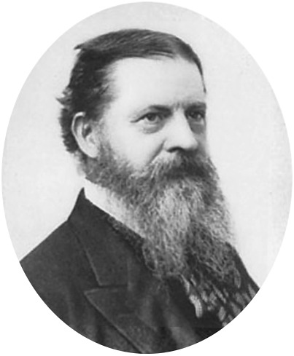
Why do we create models in science?
The pragmatic maxim
It appears, then, that the rule for attaining the third grade of clearness of apprehension is as follows: Consider what effects, that might conceivably have practical bearings, we conceive the object of our conception to have. Then, our conception of these effects is the whole of our conception of the object.
– Charles Sanders Peirce. 1878. How to make our ideas clear. Popular Science Monthly 12:286-302
Modeling is the process whereby we develop abstract, quantitative representation to make our ideas clear.

Slide 4
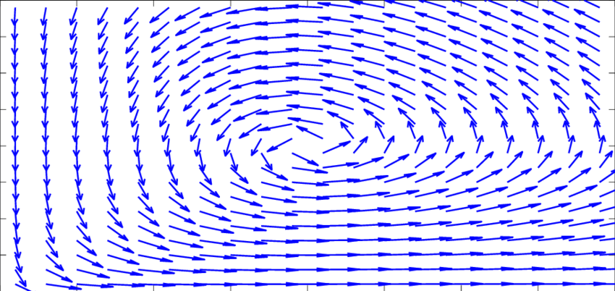
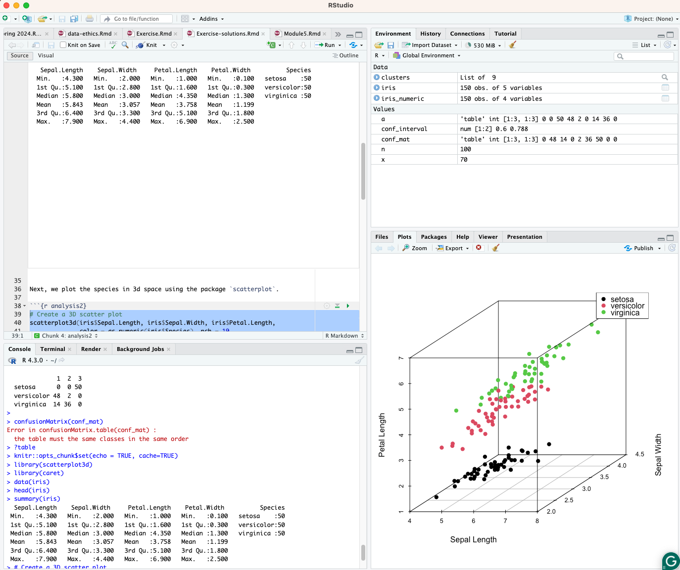

Where did modeling come from and where is it going?
Past
Present
Future
Niche area
Mostly focused on theory
Pervasive
Scripted analysis
Reproducible workflows
Data repositories
Collaborative
Modular, deployed systems
Theory and data assimilation

Slide 5

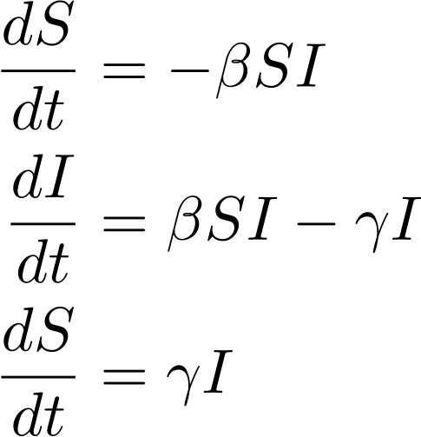
What are scientific models?
First Law of Information: There is no information without data.
i.e., You can't get something from nothing
Models are not oracles.
Models cannot make up for ignorance.
Modeling is not a magical bridge to cross an information gap.

Slide 6

Models are representations of our ideas

Slide 7

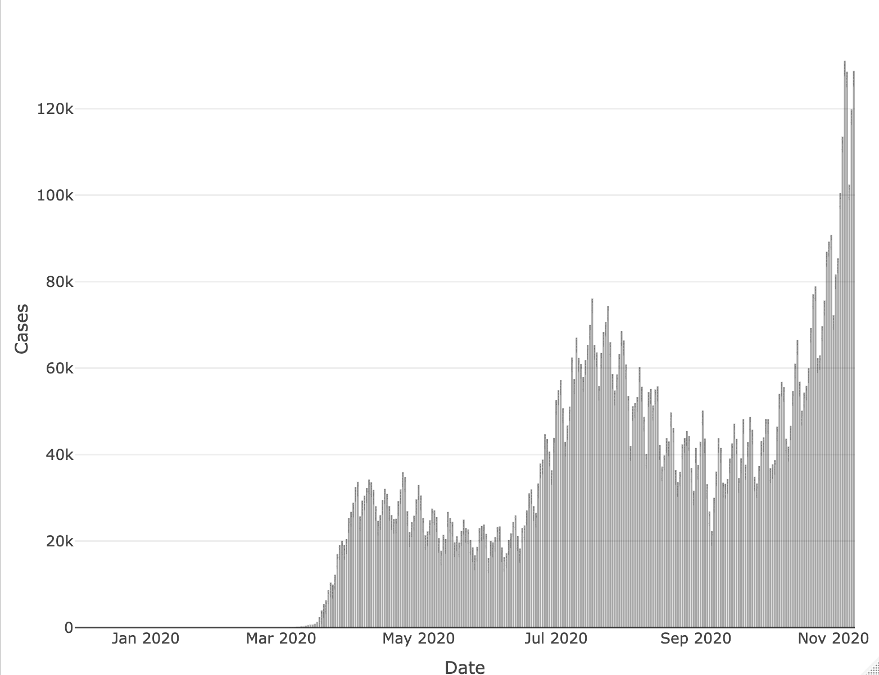
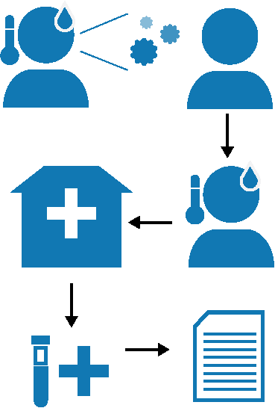
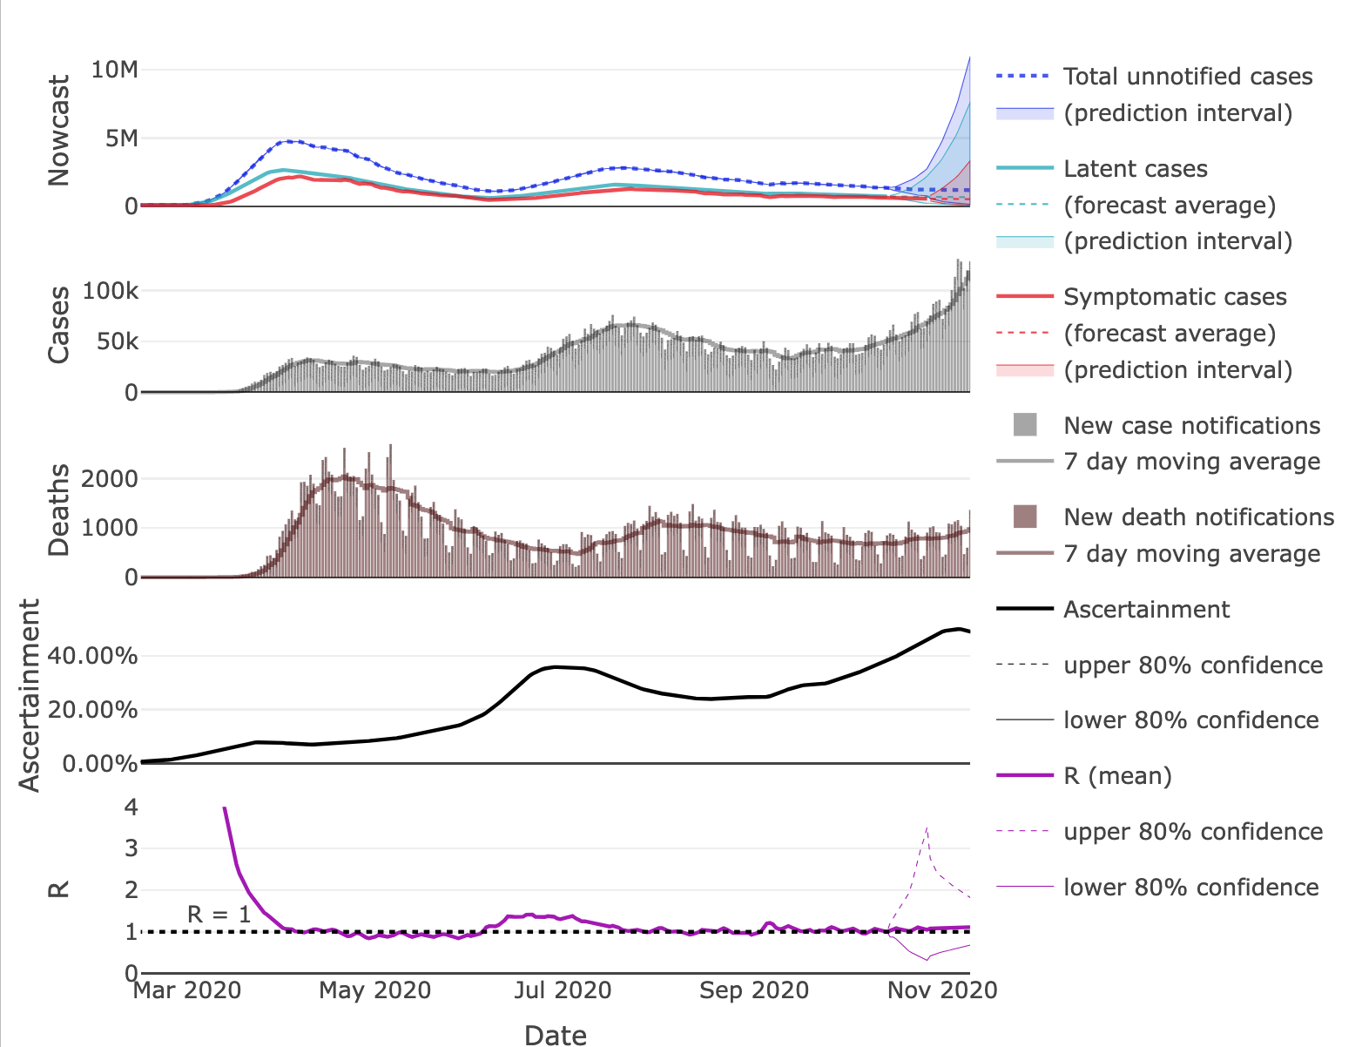
What are scientific models?
What are models if not oracles?
Instruments Discovering underlying data generating mechanisms → abstract understanding
Modeling
Data generation
Data
John M. Drake et. al. (2020). “Nowcasts for the US, states, and territories.” https://www.covid19.uga.edu/nowcast
nowcast
case reports
case reports
death reports
ascertainment
reproductive number

Slide 8
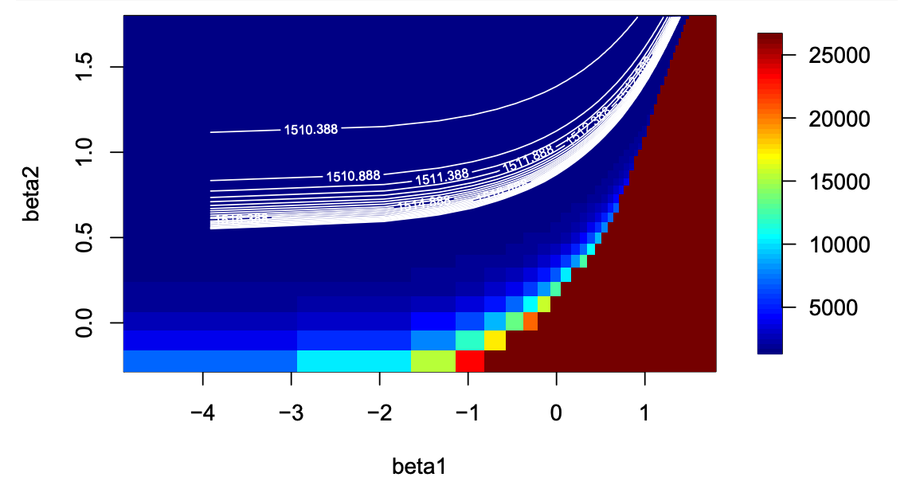

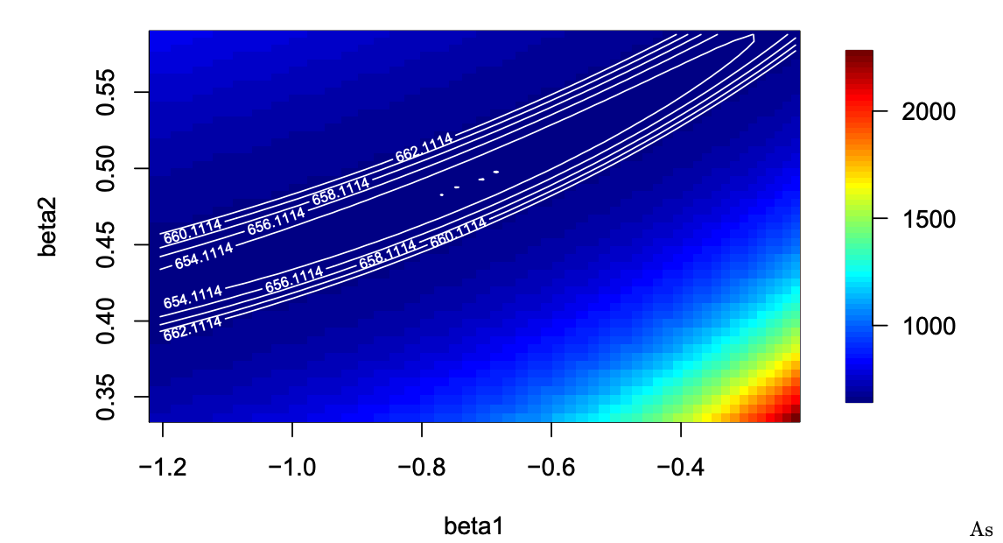
What are scientific models?
What are models if not oracles?
Teachers Interrogating data & ideas → practical expertise
i.e., Learning by doing.
Model identifiability in an ongoing project on the spatial spread of West Nile virus in North America
Model I
Modeling as a creative enterprise and the concept of “craft”
Model 2
Marchand, T.H.J. 2010. “Embodied cognition and communication: studies with British fine woodworkers.” Journal of the Royal Anthropological Institute 16:S100-S120 https://rai.onlinelibrary.wiley.com/doi/full/10.1111/j.1467-9655.2010.01612.x

Slide 9
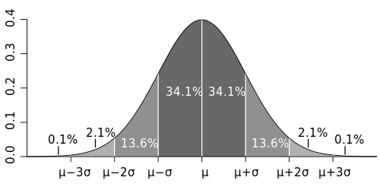


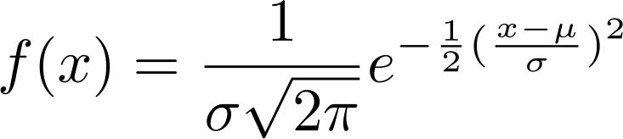
What are scientific models?
What are models if not oracles?
Tools Structured reasoning about data & ideas → knowledge objects
Data
Quantitative tools for Quantitative tasks
Structured reasoning about data
Knowledge objects
Codified, transferable units of information derived from quantitative analysis

Slide 10
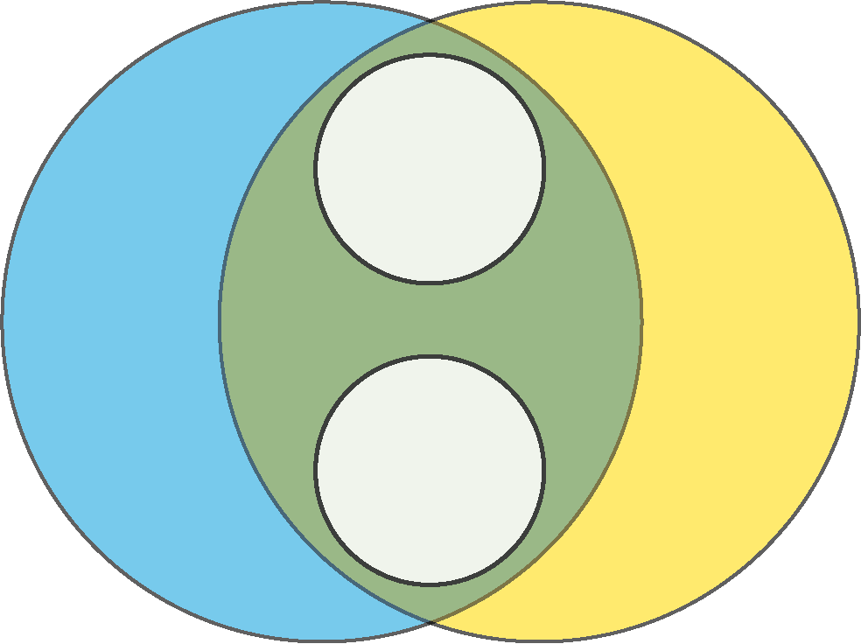
What kinds of ideas can we make models for?
Ideas about concepts
Ideas about data
Statistically fitting mechanistic models to estimate unknown parameters
Statistical models & machine learning
Mechanistic models
Hybrid models
Semiparametric models

Slide 11
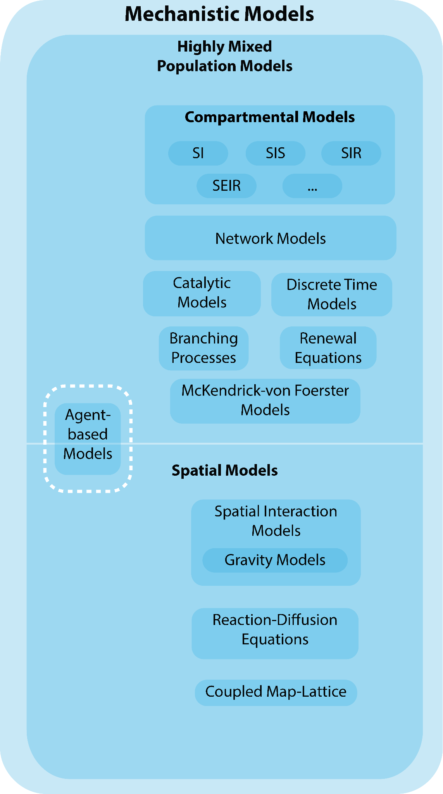
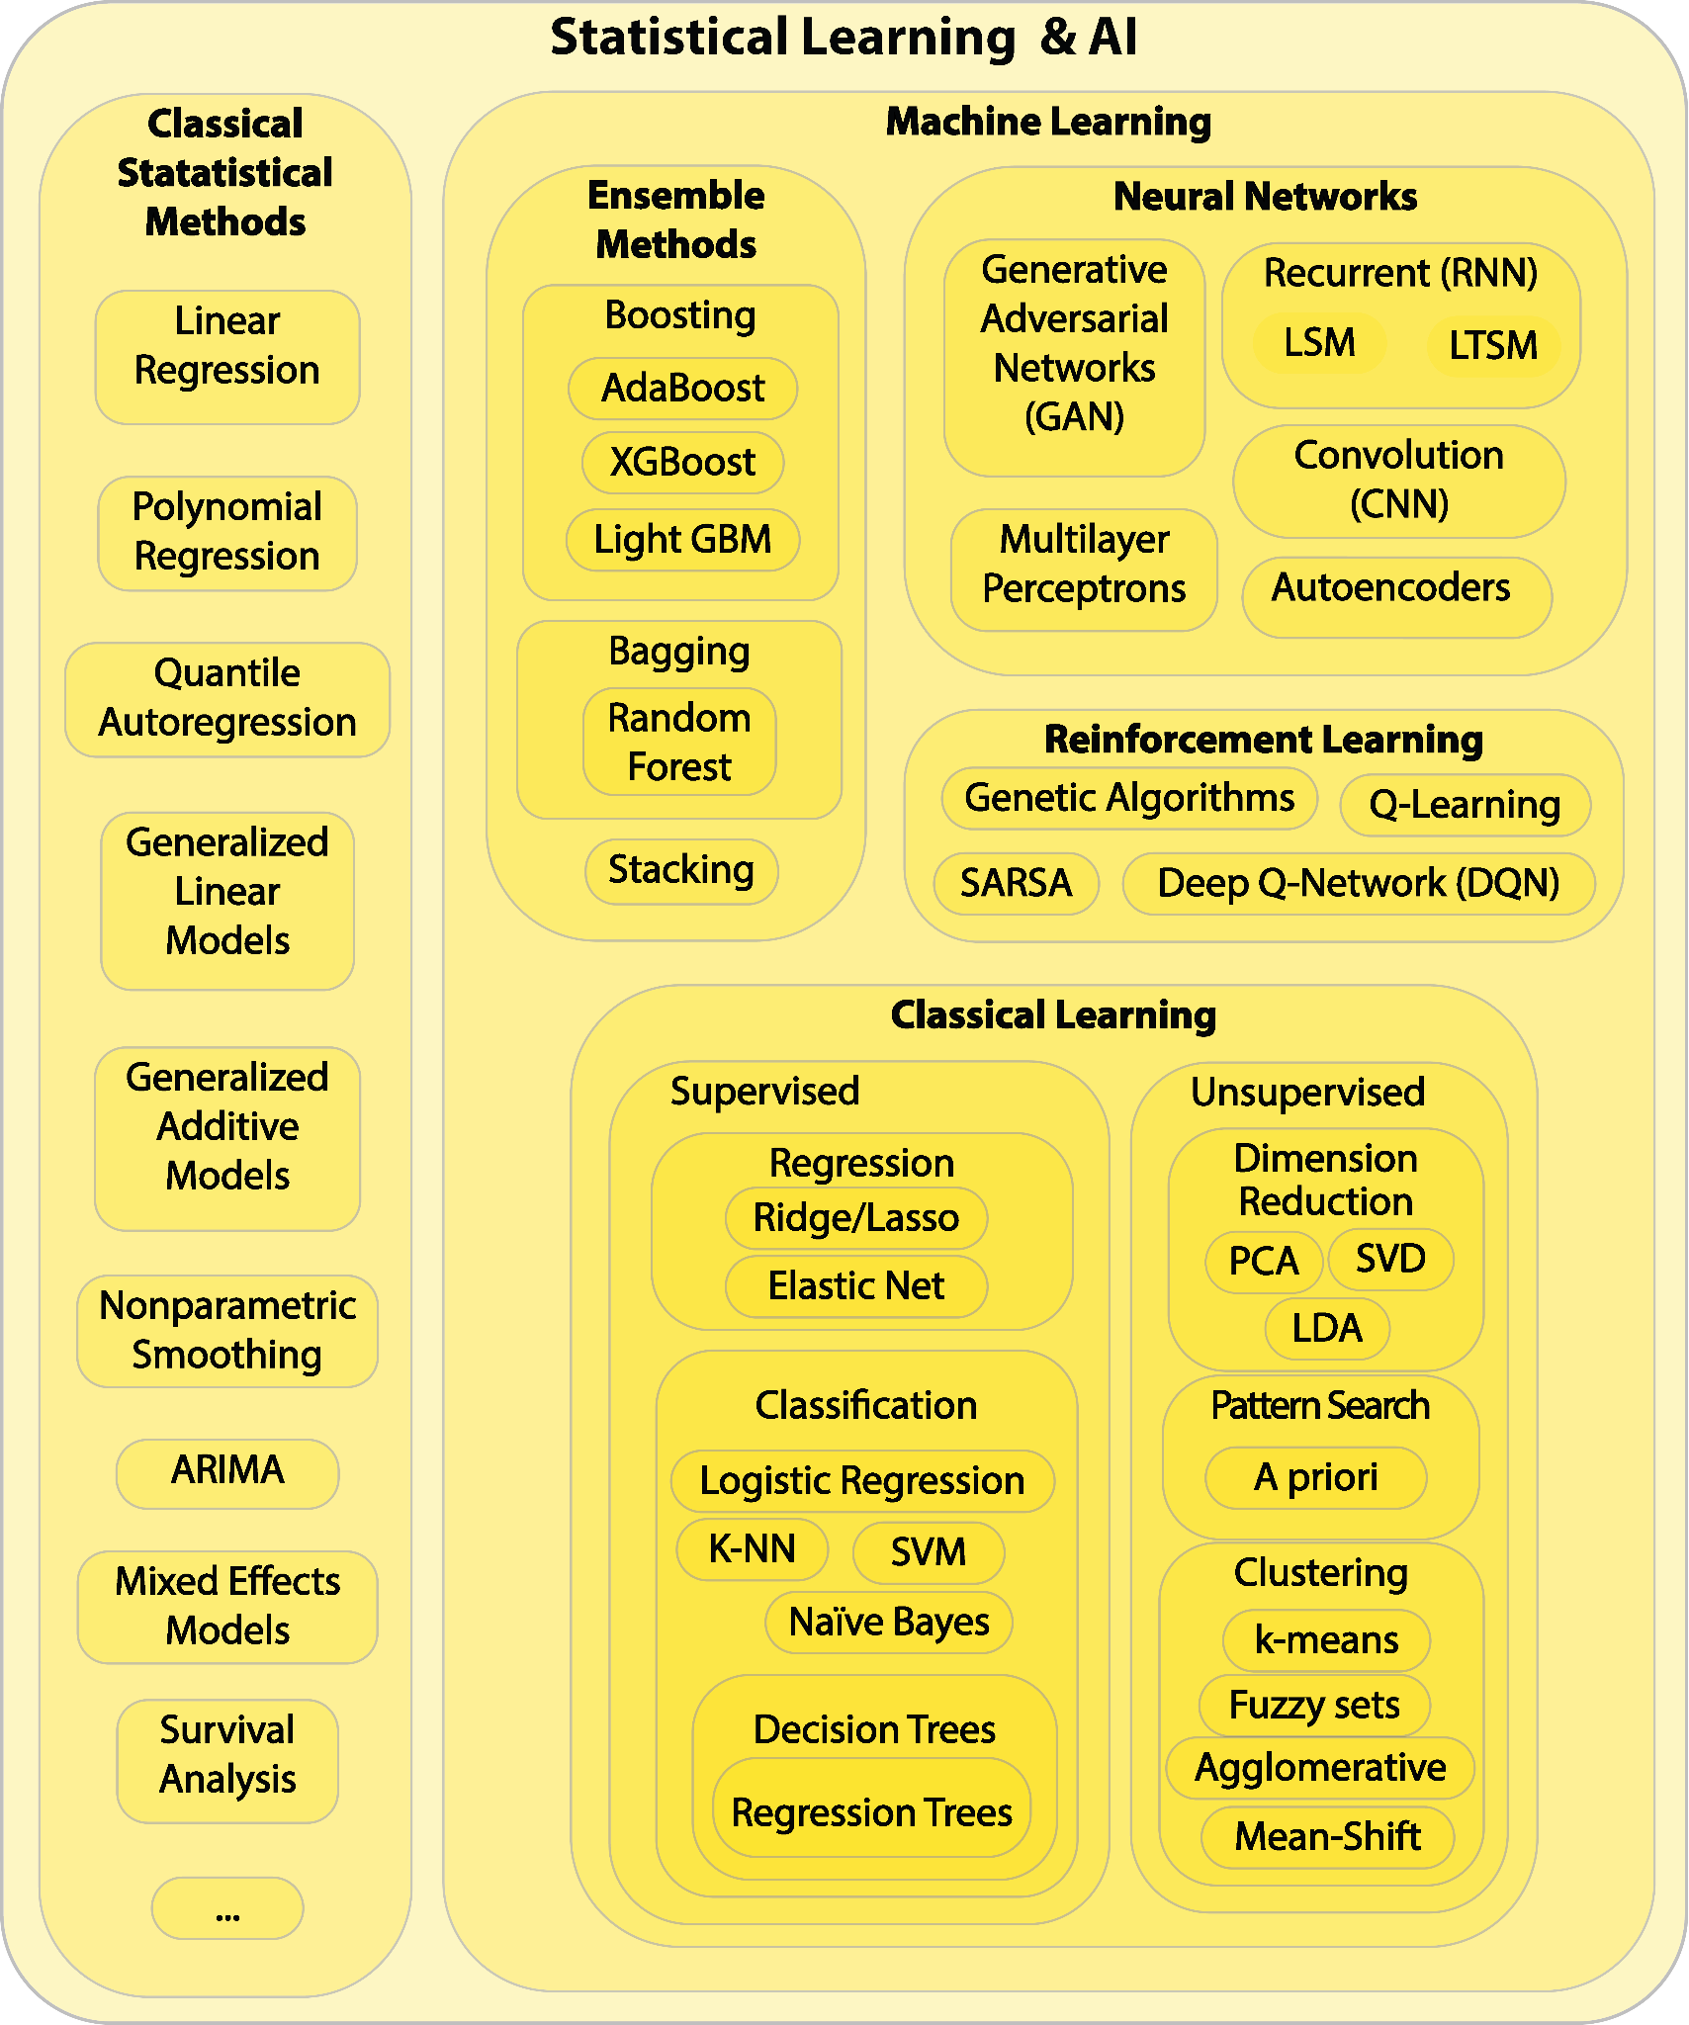
What kinds of ideas can we make models for?
Ideas about concepts
Ideas about data

Slide 12
What can models do? (a plea for pluralism)
Estimation How much…?
Inference What can we conclude?
Forecasting What will happen when?
Counterfactuals What if…?
Visualization A picture is worth…
Quantifying uncertainty What is probable? possible?
Assessing coherence Are our ideas consistent?

Slide 13



How are models used in translational science?
Update questions, tools, data, & actions continuously.
Data
Analytics & Modeling
Actions
Questions
Action Space
?
?
?
SME
SME
Data
Tools
Action space and decisions are also informed by other information
Other information
Policy, etc.

Slide 14
Thank you!
John M. Drake
University of Georgia
Email: jdrake@uga.edu

Slide 15
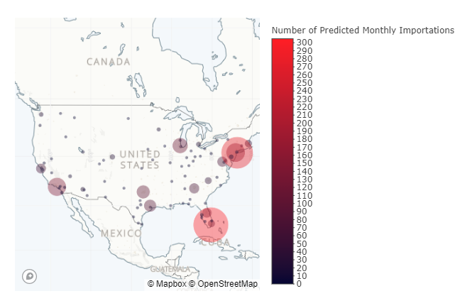
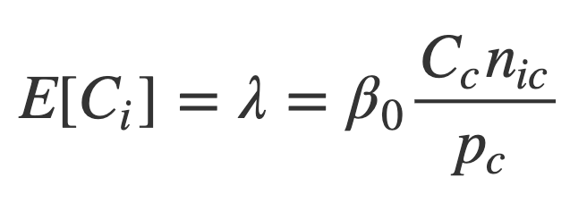
CDC Covid Importation Model
Information support for federal decision-making
What did it do?
Prediction
Data
Global airport “catchments”
Estimated prevalence in source locations
Official Airline Guide prospective passenger booking data
Questions
Where are the majority of imported cases expected to enter the US?
Where are the majority of imported cases expected to originate?
monthly passenger volume from source country c to POE i
new cases in source country c
imported cases at POE i
population of source country c
covid19.uga.edu/us-importation-risk
Notes:
With support from, and for the benefit of, the CDC Division of Global Migration and Quarantine, we developed a COVID-19 importation risk model to understand which port of entry airports in the United States had the greatest probability of receiving infected international passengers. Airports in metro New York (JFK and Newark Liberty) and Miami International have consistently been at the top of the list. However, port of entry airports in Atlanta, Boston, Charlotte, Chicago, Dallas-Ft.Worth, Philadelphia, and San Francisco have also had a high probability of receiving infected passengers. We developed this model for COVID-19. However, we can develop importation risk models for other infectious diseases.

Slide 16
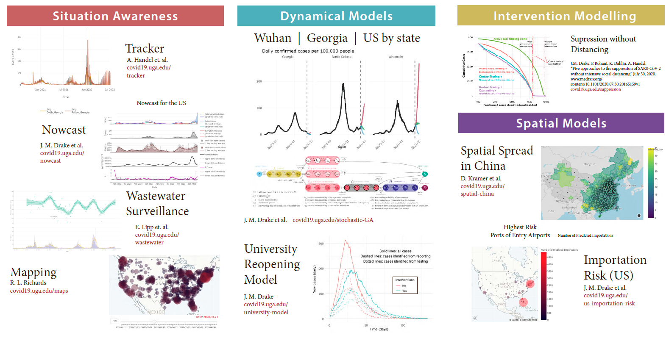
Situational awareness during COVID-19
sease Forecasting
Disease Mapping
Behavior & Infectious Disease
Coronavirus
Spillover

Slide 17
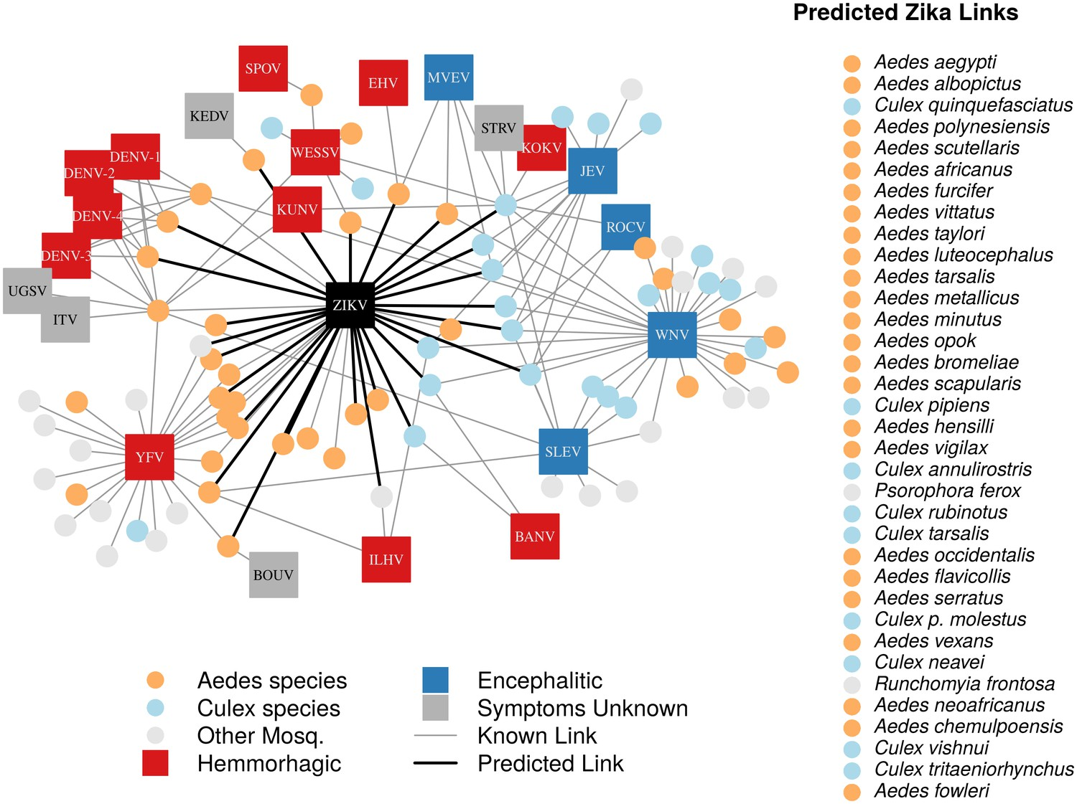
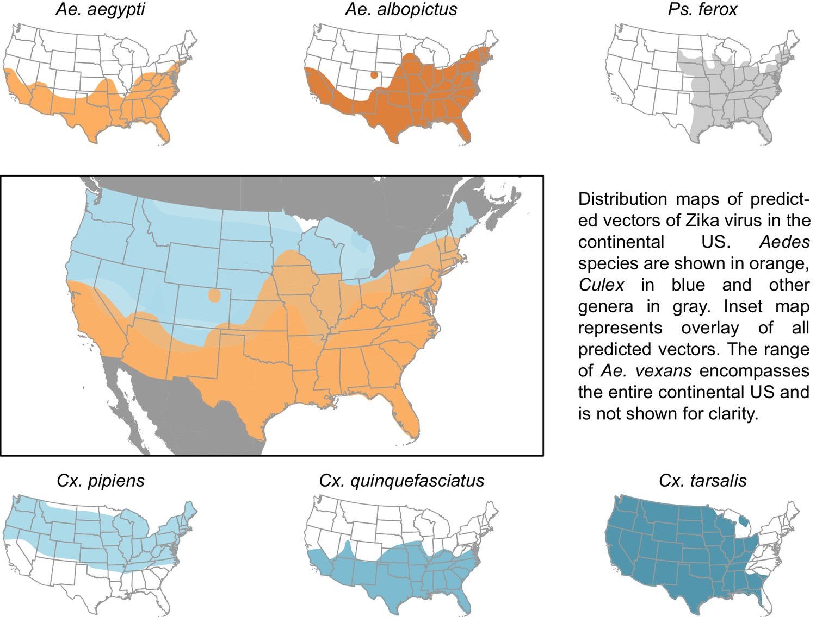
Predictive modeling of an emerging vector-borne disease
Network diagram of mosquito vectors (circles) and their flavivirus pairs (rectangles).
Distribution map of predicted vectors of Zika virus in the continental US.
Vectors of Zika Virus
Evans, M.V. et al. Data-driven identification of potential Zika virus vectors. eLife. Feb 28, 2017
Notes:
So, in the pre-COVID world, another disease that was very much in the news and that people in the US were worrying about quite a lot, was Zika.
HISTORICAL BACKGROUND OF ZIKA EMERGENCE.
After the disease had become established in the Caribbean, we started to see sporadic case in Florida, and we became concerned about potential spread in the US. Since Zika is spread by mosquitos, we needed to understand where the relevant mosquitos were—or more could be—in the US to understand the risk geographically.
DETAILS ABOUT MICHELLE’S WORK.
Understanding how this risk might change over time means understanding how the vector hosts range will change over time in response to climate change.
Importantly, understanding risk of vector borne disease such as ZIKA also means drilling down to a local geography. We are currently working on understanding the distribution of vectors at the sub-neighborhood scale, and the also the temporal risk over the course of seasons and day-night cycles. This information can help agencies develop guidance and craft interventions at the local level to prevent spread.

Slide 18
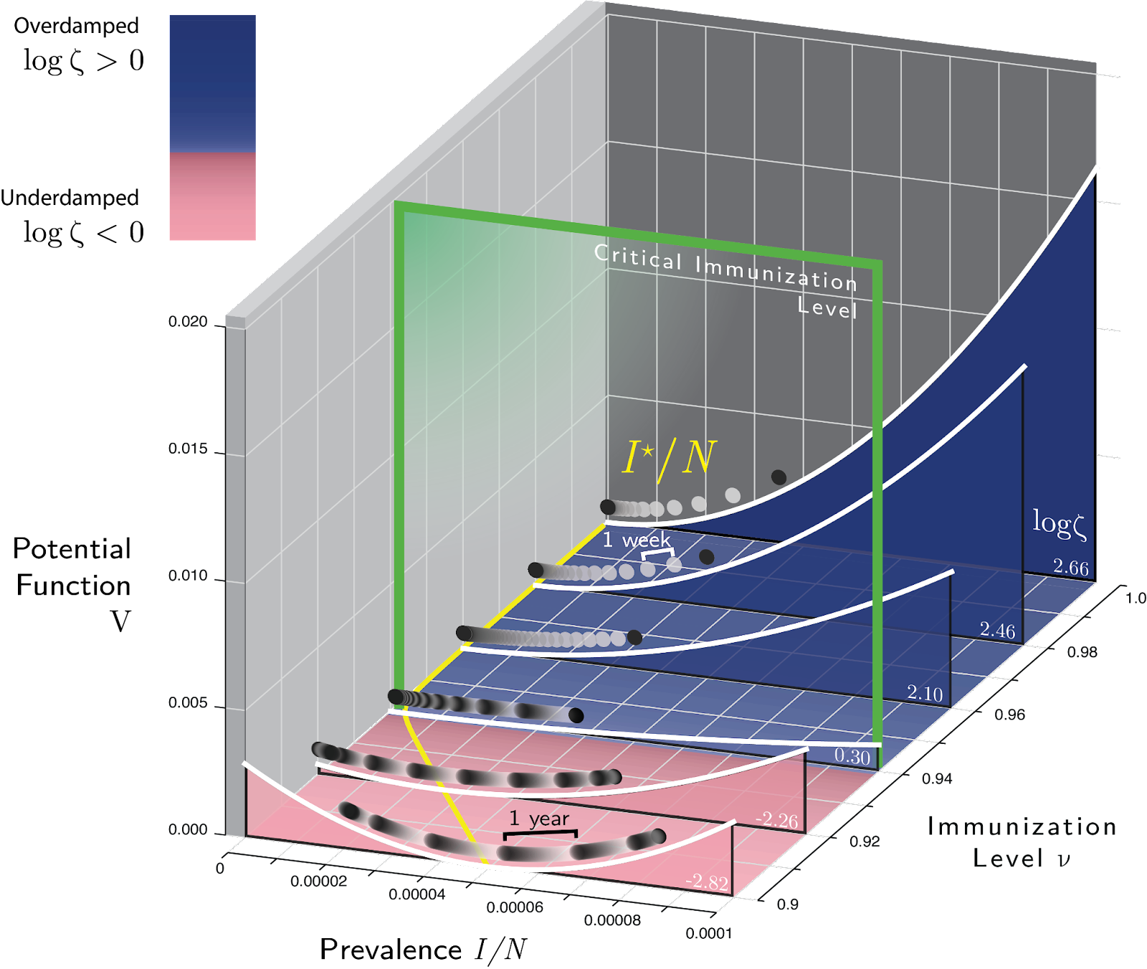

PHASE: Watch/Warning
Early warning signals
TASK: Early warning signals
Critical Slowing Down: Slowing in the decay rate of perturbations as a system approaches a critical threshold near a bifurcation.
Data requirements
Documented case numbers of historical infections.
Background surveillance data prior to disease resurgence.
Sample question(s)
Are we approaching a critical transition?
How long until an epidemic?
How forceful does intervention need to be to prevent an epidemic transition?
For relatively small perturbations, a disease system can be understood as a damped harmonic oscillator.
In a stochastic system, changes in the decay rate of perturbations characteristic of critical slowing down can be observed in statistics.
Drake, J.M., T.S. Brett, S. Chen, B.I. Epureanu, M.J. Ferrari, É.Marty, P.B. Miller, E.B. O’Dea, S.M. O’Regan, A.W. Park, P. Rohani. 2019. The statistics of epidemic transitions. PLOS Computational Biology
Notes:
Early warning signals based on the theory of critical slowing down.
Critical slowing down is a phenomenon seen in certain statistics of time series as a system approaches a transition, known as a bifurcation in mathematical terms.
Detecting critical slowing down in real data would enable us, for example, to predict when a disease present at low levels, like measles, is about to undergo a transition to a full blown epidemic.
The signal of critical slowing down can be seen in many kinds of statistics, and these are collectively known as bifurcation-based EWS.
NEXT SLIDE

Slide 19
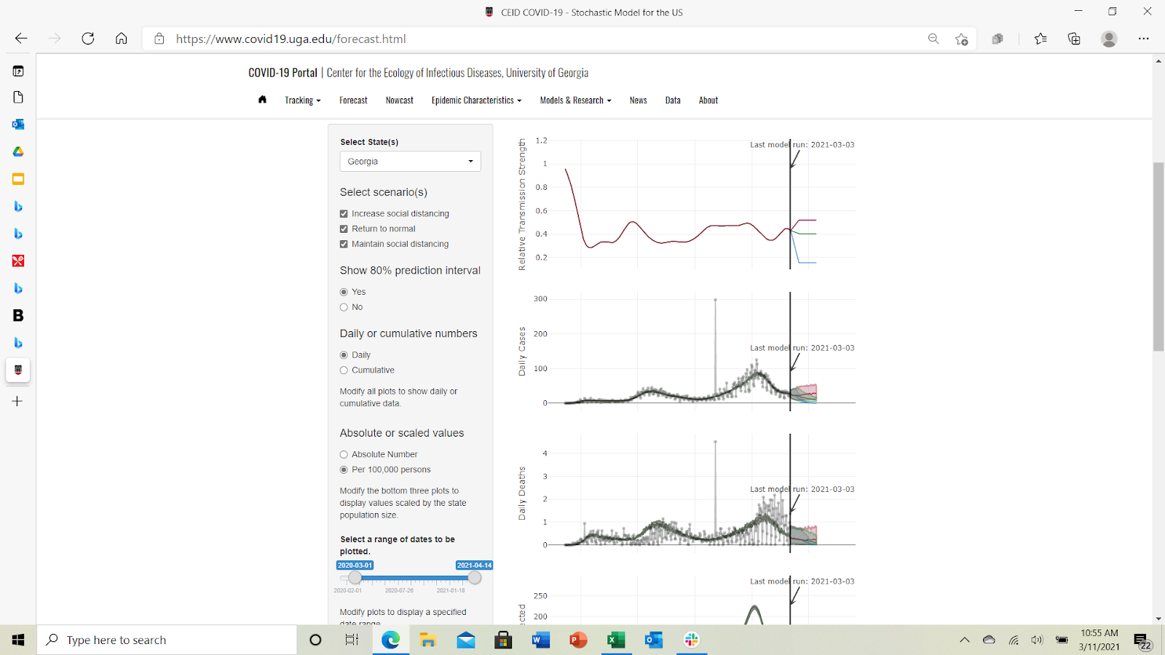
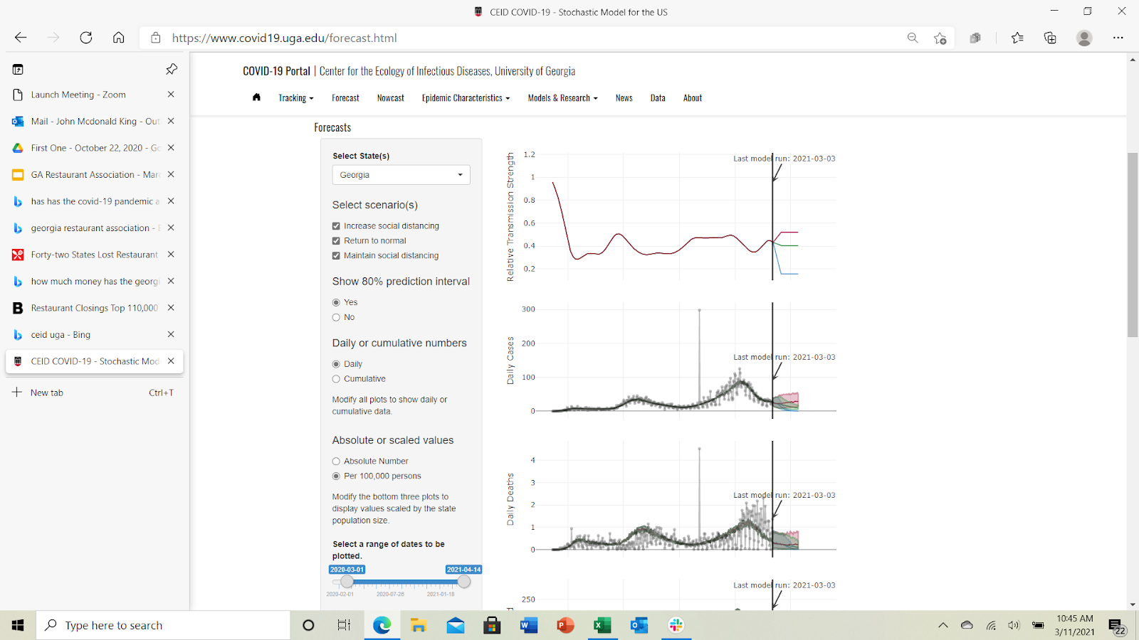
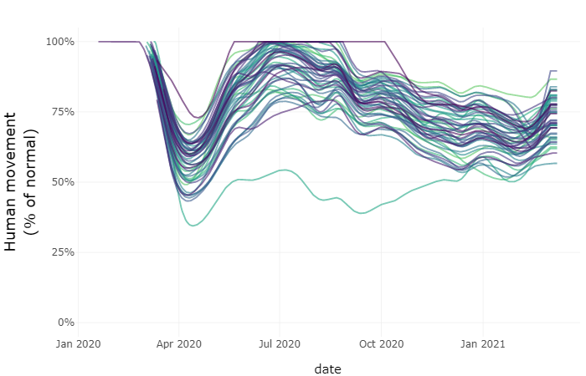
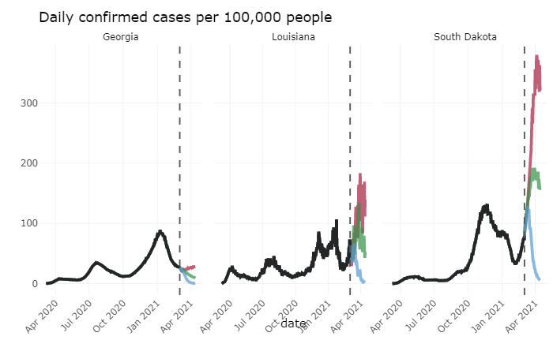
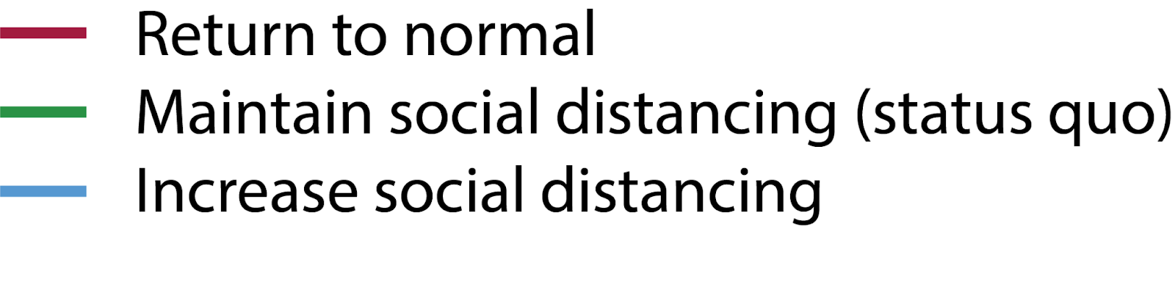
PHASE: Emergency
Forecasting and scenario analysis
Forecasting & scenario analysis
Relative Transmission Strength
Relative Mobility by State
Daily Cases per 100,000
Daily Cases per 100,000 People
Daily Deaths per 100,000 People

Slide 20
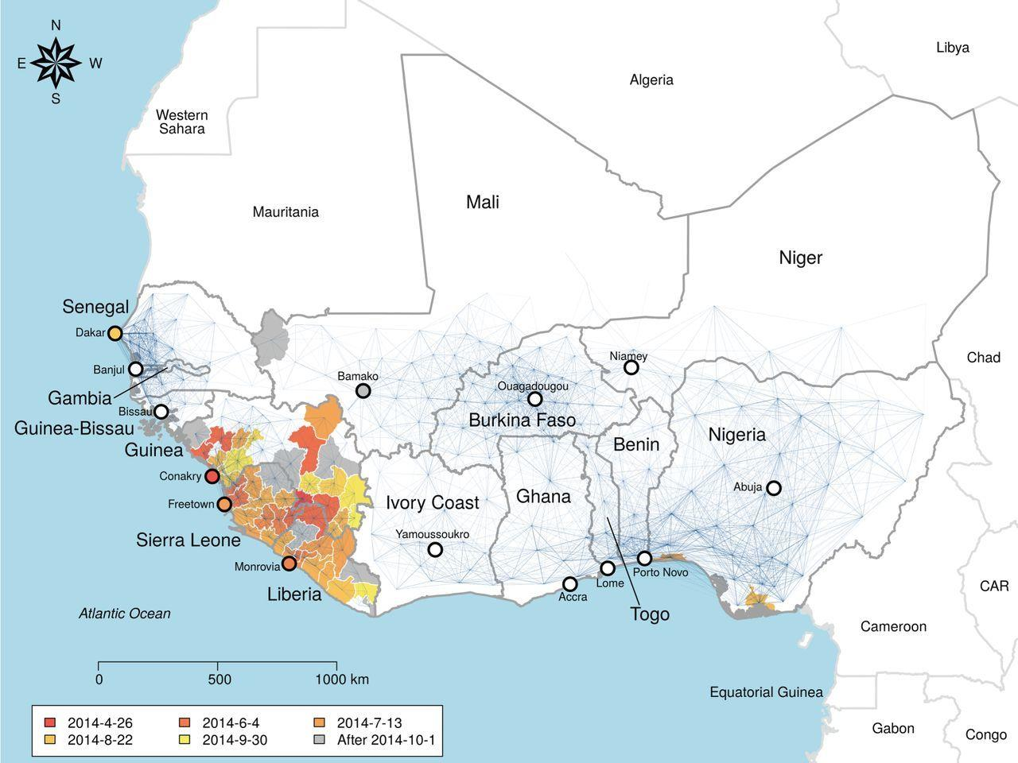
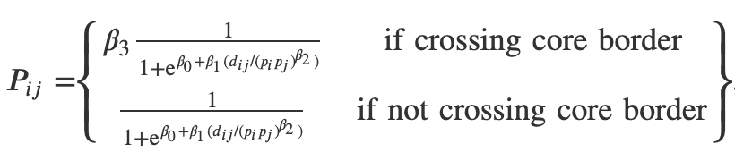
PHASE: Emergency
Spatial interaction models of the West African Ebola epidemic
TASK: Estimation and prediction analysis
Best fit: gravity model with decreased transmission from the core countries to the rest of the region with these link weights:
Network of transmission probability.
Line thickness is proportional to transmission probability.
The model considers distance, population density, and whether links cross the border surrounding Guinea, Liberia and Sierra Leone.
Kramer, A.M., J.T. Pulliam, L.W. Alexander, A.W. Park, P. Rohani and J.M. Drake. 2016. Spatial spread of the West Africa Ebola epidemic. Royal Society Open Science
Notes:
[slide duration: MAX 1 min]
Network of Ebola virus transmission probability in West Africa. Blue lines represent the transmission probability for the best-fit model, which includes effects of distance, population density and whether links cross the border surrounding Guinea, Liberia and Sierra Leone. Thickness is proportional to transmission probability, nodes are administrative unit centroids. The map is fully connected and invisible links represent orders of magnitude lower transmission probability. Administrative units used to fit the model are coloured by date of infection. Infections recorded after 1 October are coloured grey and were not included in the model fit.

Slide 21
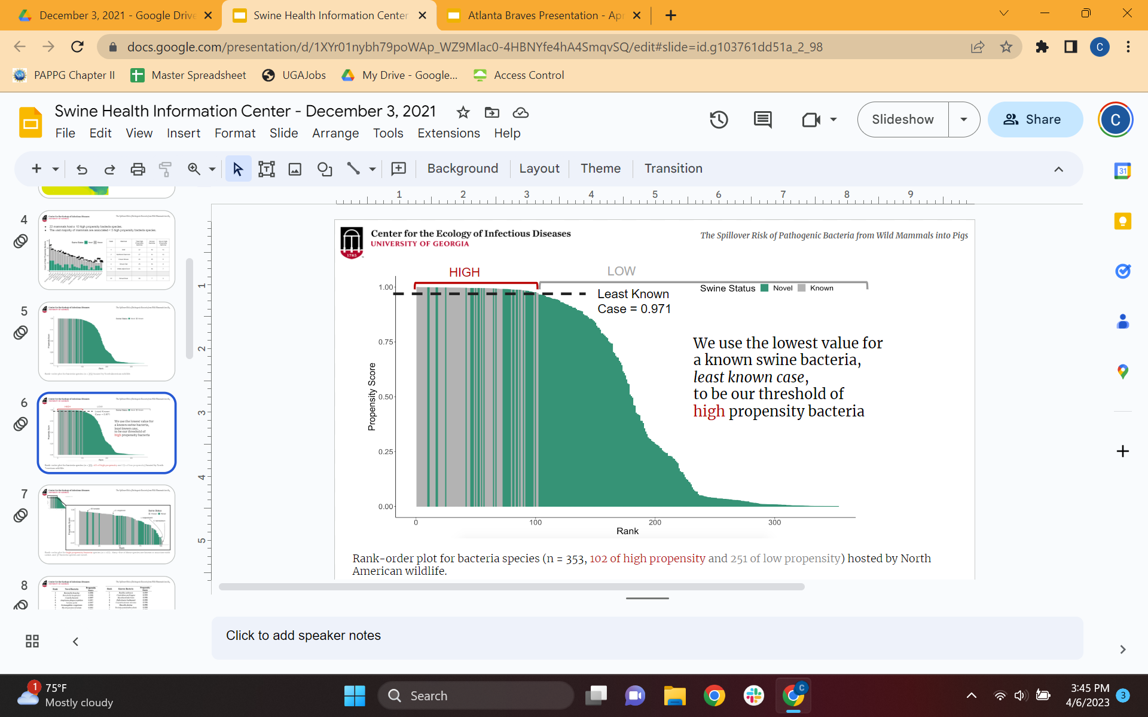
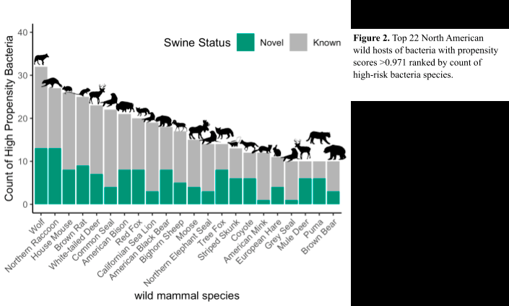
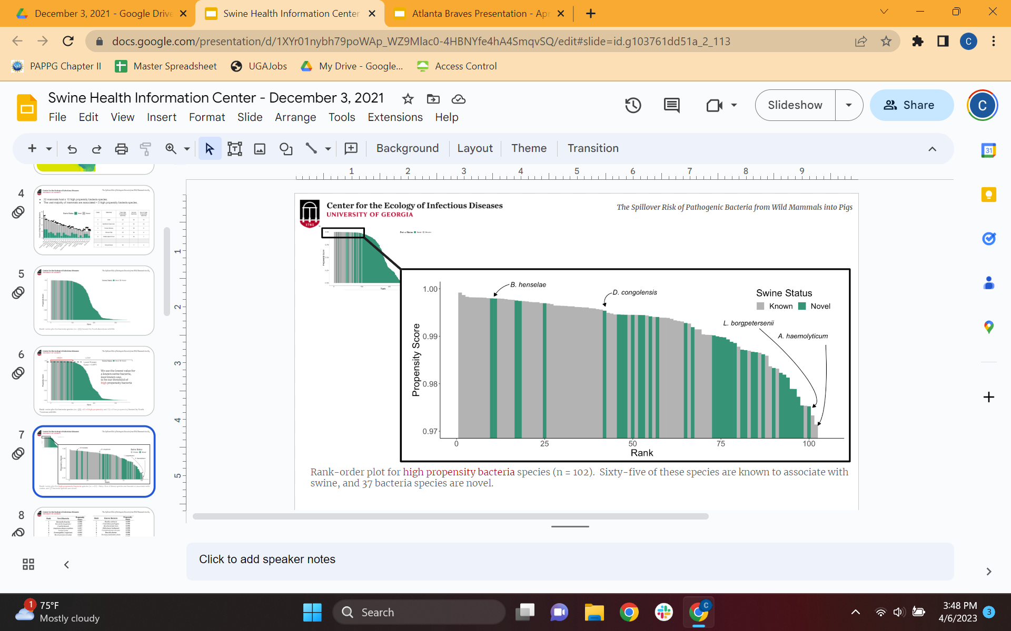
Data-driven risk modeling for spillover
Spillover Risk of Pathogenic Bacteria
Evans, M.V. & J.M. Drake. 2022. A Data-driven Horizon Scan of Bacterial Pathogens at the Wildlife–livestock Interface. Ecohealth 19:246-258.

Slide 22
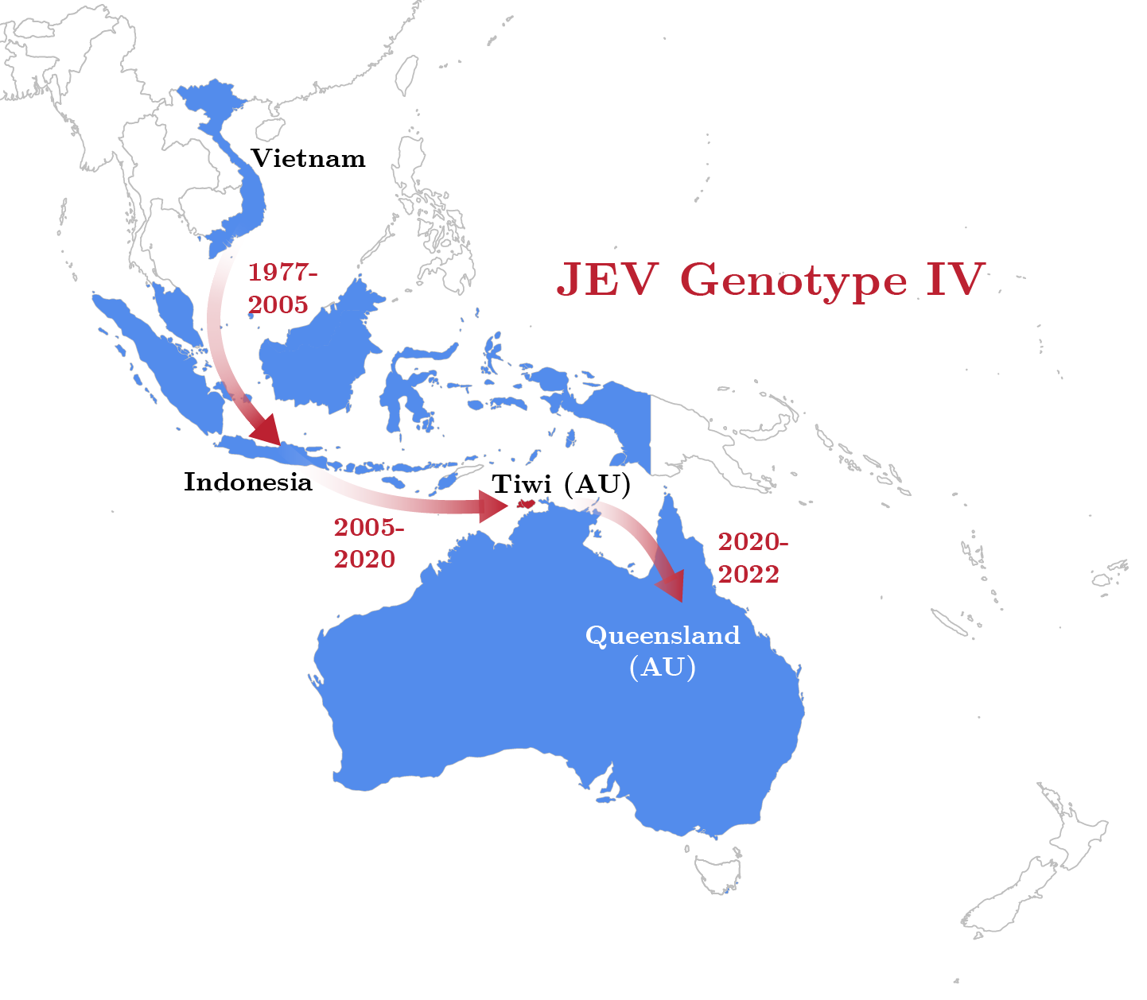
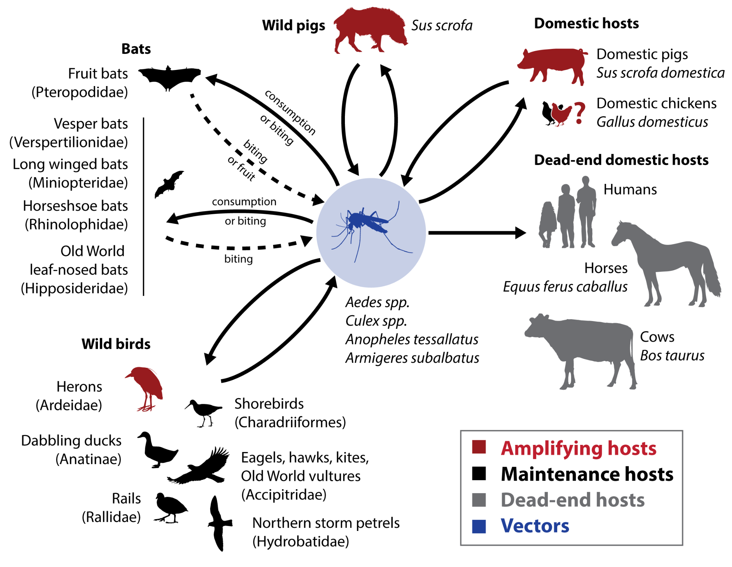
Modeling spread scenarios
Japanese encephalitis virus
The CEID is building a model of the 2022 Australian JEV genotype IV outbreak. This model will be used to forecast how a JEV outbreak in the United States may spatiotemporally spread if JEV infected mosquitoes are imported into the country. CEID launched the Japanese Encephalitis Virus Information Sharing Network (JEVISN) website.

Slide 23
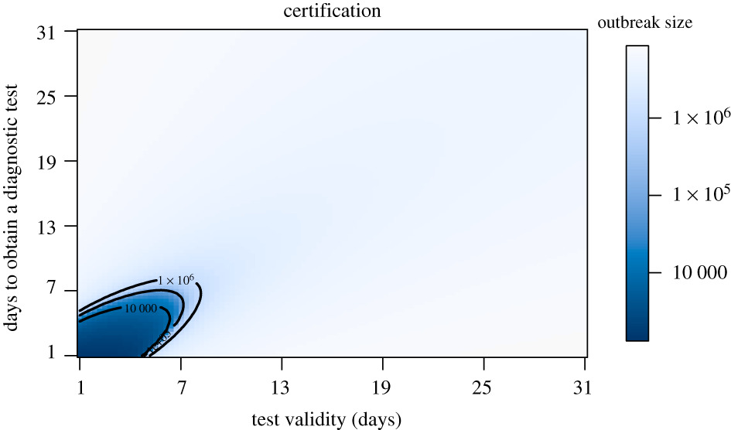
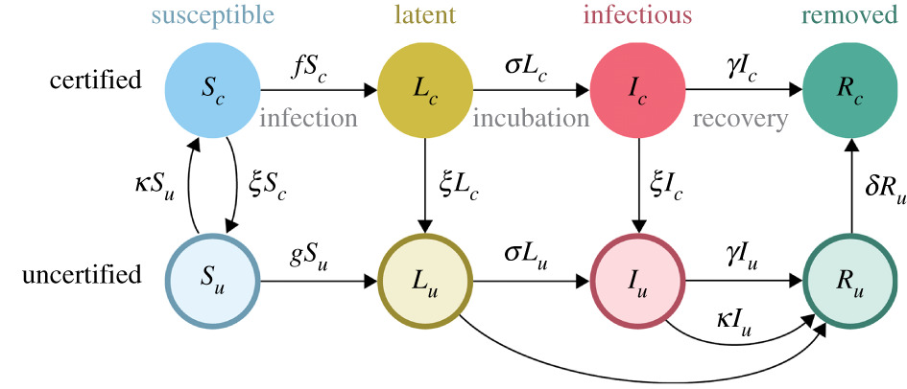
Two models for controlling SARS-CoV-2 with medical countermeasures
Conceptual understanding of alternative management strategies
Final outbreak size as a function of viral test validity duration (1/ξ) and test waiting time (1/κ) without generalized interventions. At the assumed value of presymptomatic transmission (b_{L} = 0.44), there is only a very small region (dark blue) within which certification can prevent a major epidemic. Outbreak size is given on a log₁₀ scale.
Compartmental model for certifying infection status.
Drake, J.M. K. Dahlin, P. Rohani & A. Handel. 2021. Five approaches to the suppression of SARS-CoV-2 without intensive social distancing. Proceedings of the Royal Society B 288:20203074.

